Slide 1
Simulation Modeling and Performance Evaluation
Lecture 07
Simulation Development Example
Single Server Queueing System (SSQS)
Muhammad Mahbub Alam
Professor
CSE Department, IUT

Slide 2
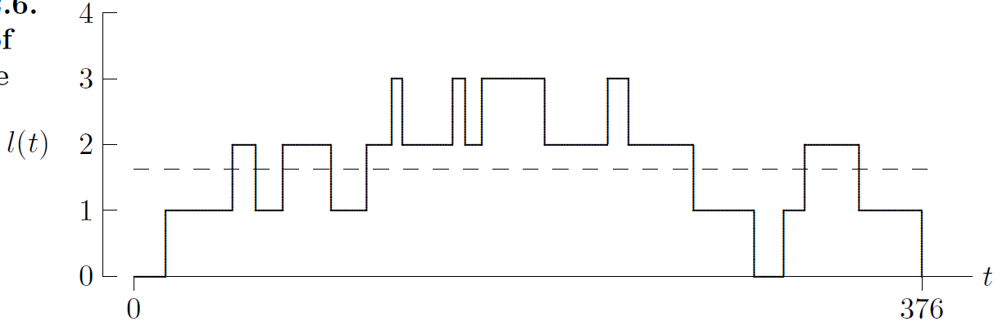
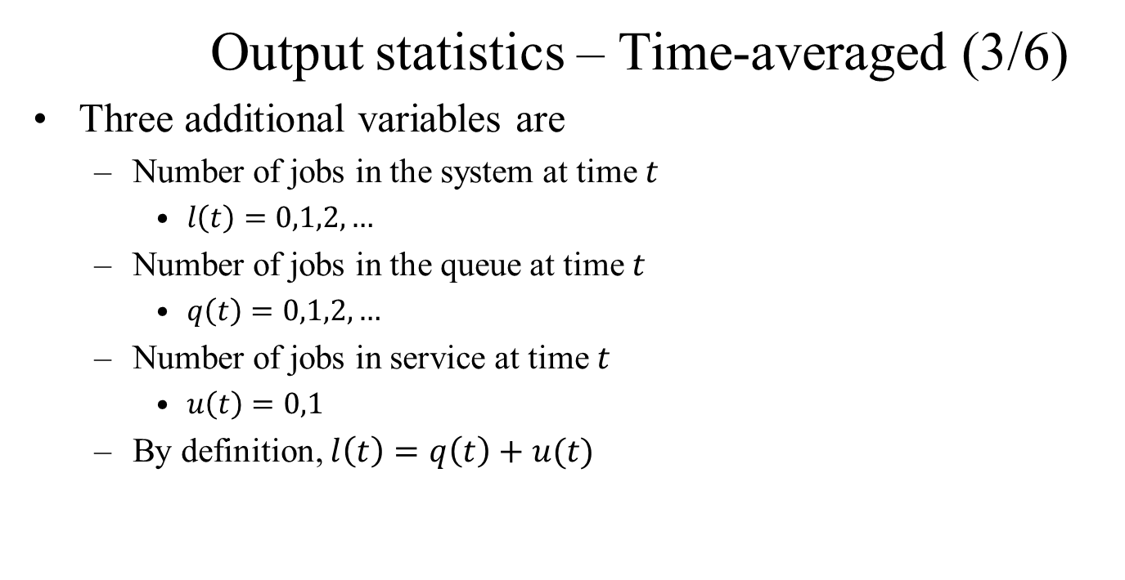
SSQS – Step 3: Specification Model (10/14)
Output statistics – Time-averaged (3/6)
Three additional variables are
Number of jobs in the system at time $t$
$l\left(t\right)=0,1,2, …$
Number of jobs in the queue at time $t$
$q\left(t\right)=0,1,2, …$
Number of jobs in service at time $t$
$u\left(t\right)=0,1$
By definition, $l\left(t\right)=q\left(t\right)+u(t)$
Time-averaged number in the system

Slide 3
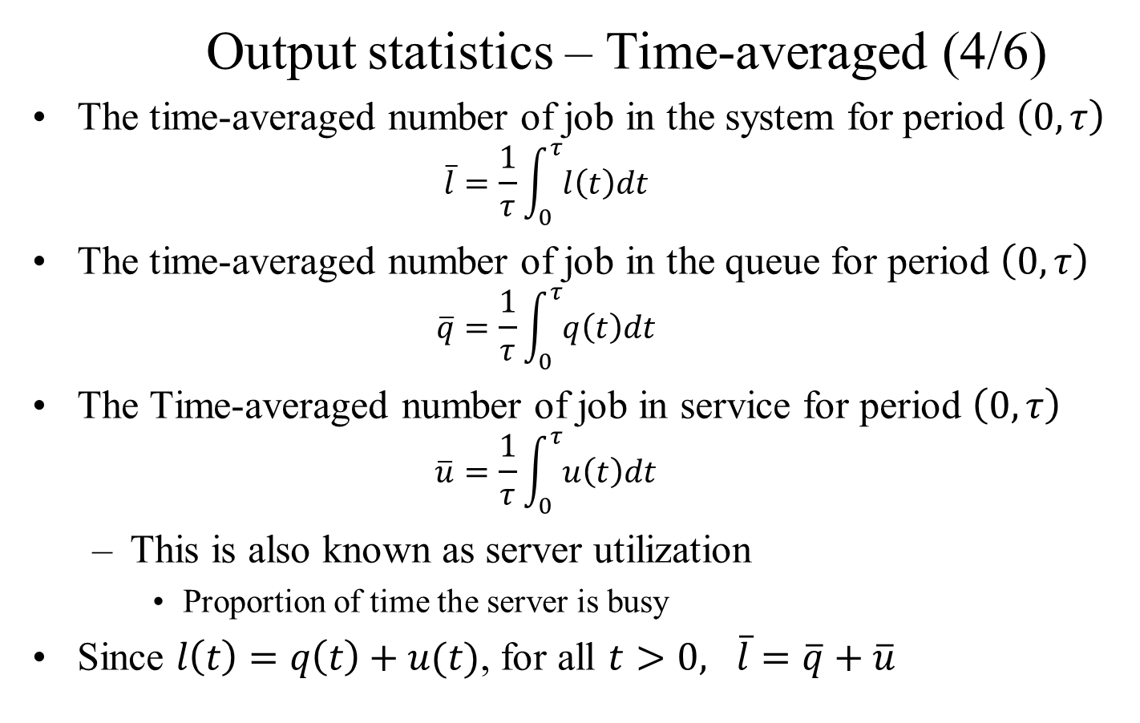
SSQS – Step 3: Specification Model (11/14)
Output statistics – Time-averaged (4/6)
The time-averaged number of job in the system for period $\left(0,τ\right)$
$$\overline{l}=\frac{1}{τ}\int_{0}^{τ}{l\left(t\right)dt}$$
The time-averaged number of job in the queue for period $\left(0,τ\right)$
$$\overline{q}=\frac{1}{τ}\int_{0}^{τ}{q\left(t\right)dt}$$
The Time-averaged number of job in service for period $\left(0,τ\right)$
$$\overline{u}=\frac{1}{τ}\int_{0}^{τ}{u\left(t\right)dt}$$
This is also known as server utilization
Proportion of time the server is busy
Since $l\left(t\right)=q\left(t\right)+u(t)$, for all $t>0, \overline{l}=\overline{q}+\overline{u}$

Slide 5
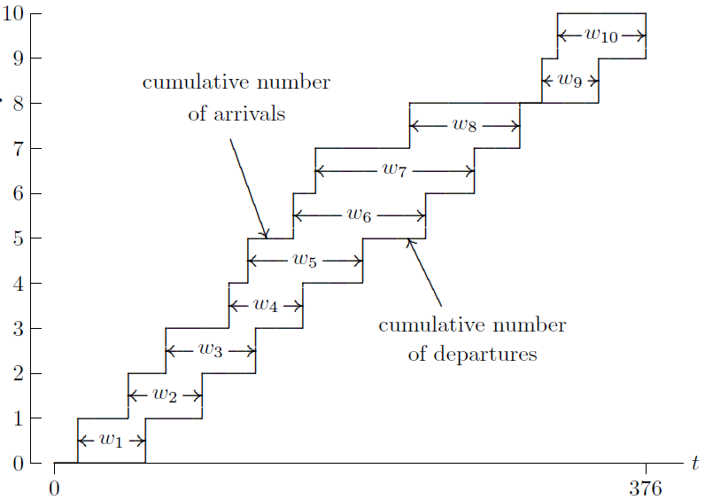
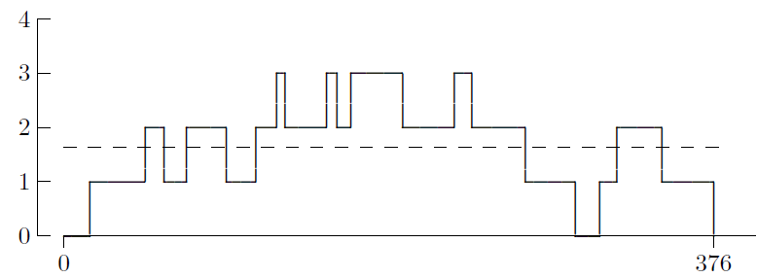
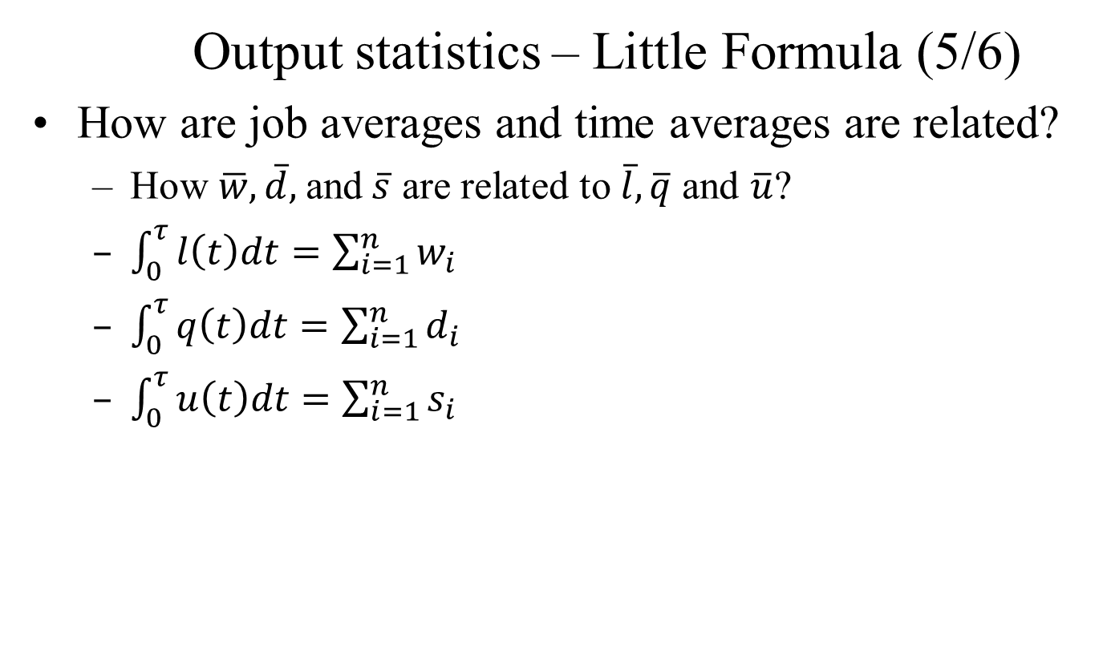
SSQS – Step 3: Specification Model (12/14)
Output statistics – Little Formula (5/6)
How are job averages and time averages are related?
How $\overline{w}, \overline{d},$and$\overline{s}$ are related to $\overline{l}, \overline{q}$ and $\overline{u}$?
$\int_{0}^{τ}{l\left(t\right)dt=\sum_{i=1}^{n}{w_{i}}}$
$\int_{0}^{τ}{q\left(t\right)dt=\sum_{i=1}^{n}{d_{i}}}$
$\int_{0}^{τ}{u\left(t\right)dt=\sum_{i=1}^{n}{s_{i}}}$

Slide 7
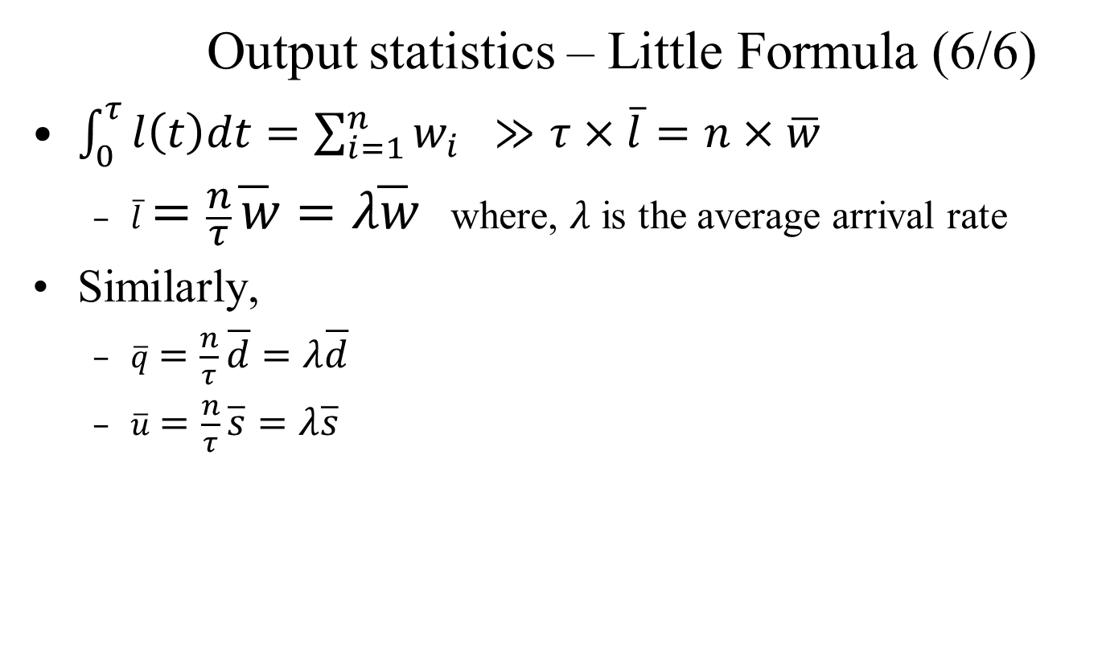
SSQS – Step 3: Specification Model (13/14)
Output statistics – Little Formula (6/6)
$\int_{0}^{τ}{l\left(t\right)dt=\sum_{i=1}^{n}{w_{i}} ≫τ×\overline{l}=n×\overline{w}}$
$\overline{l}=\frac{n}{τ}\overline{w}=λ\overline{w}$ where, $λ$ is the average arrival rate
Similarly,
$\overline{q}=\frac{n}{τ}\overline{d}=λ\overline{d}$
$\overline{u}=\frac{n}{τ}\overline{s}=λ\overline{s}$

Slide 8
SSQS – Step 3: Specification Model (14/14)
Input Data Modeling
Event occurrence time of each of the events
How the time value is calculated
Relative Timing
Absolute Timing
How the data is provided, i.e., source of data
Sample data collection
Random data generation

Slide 9
SSQS – Step 3: Specification Model (14/14)
Input Data Modeling – Absolute Timing
Exact timing w.r.t the simulation start time
Need to know the timing information before starting the simulation
Data must be available before simulation starts
Sort the data
Runtime data generation is not possible
Uncertainty about the data size

Slide 10
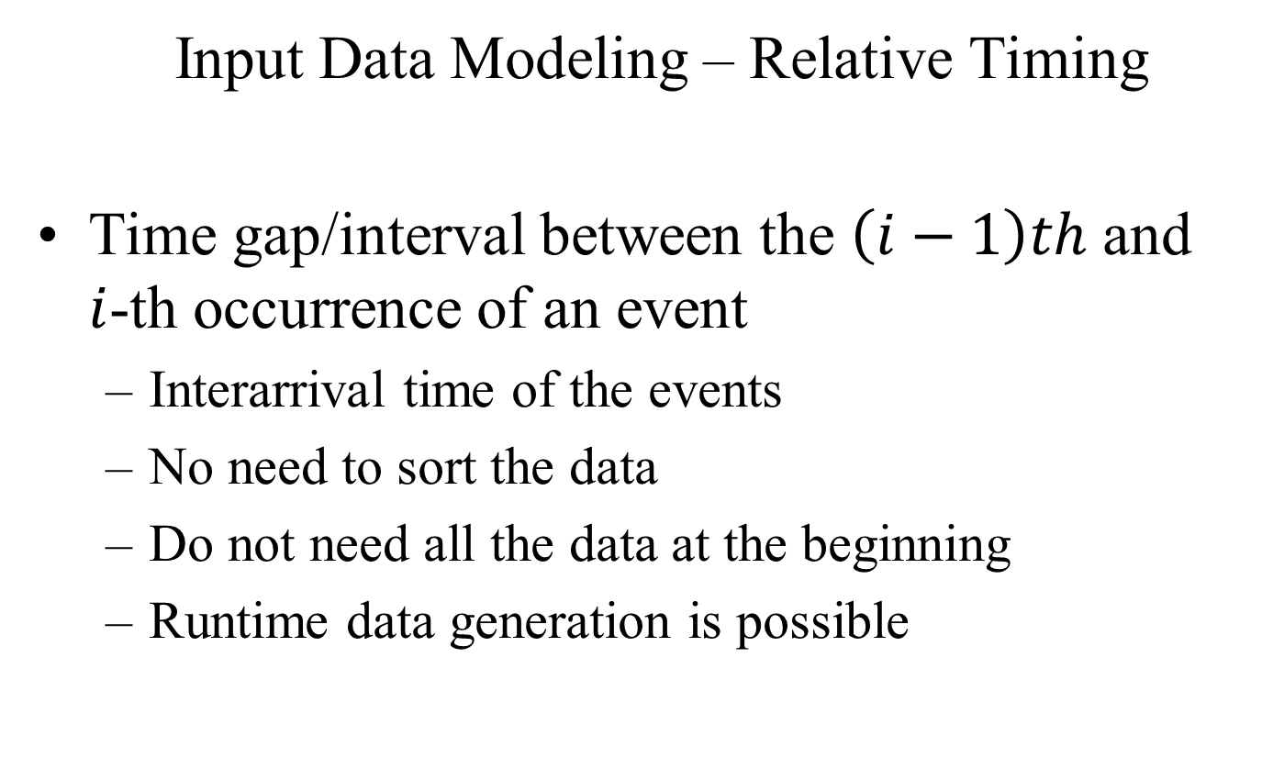
SSQS – Step 3: Specification Model (14/14)
Input Data Modeling – Relative Timing
Time gap/interval between the $\left(i−1\right)th$ and $i$-th occurrence of an event
Interarrival time of the events
No need to sort the data
Do not need all the data at the beginning
Runtime data generation is possible

Slide 11
SSQS – Step 3: Specification Model (14/14)
Input Data Modeling – Source of Data
Sample data
Might not be available
Difficult to collect
Difficult to predict the required data size
Randomly Generated data
Easy to generate
Probabilistic distribution is used
Runtime data generation is possible

Slide 12
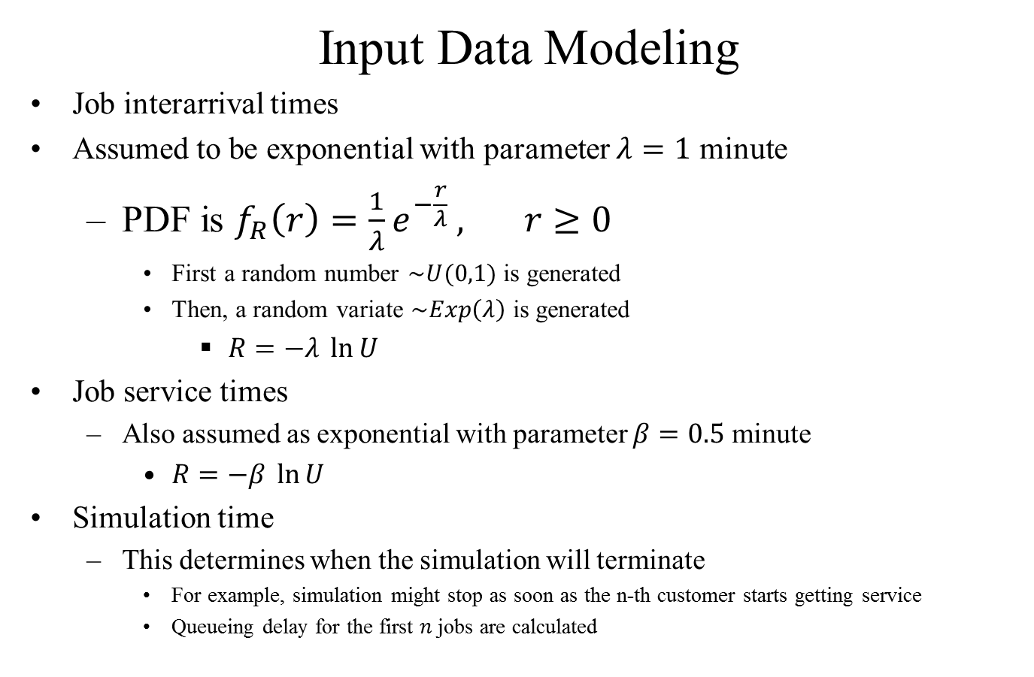
SSQS – Step 3: Specification Model (14/14)
Input Data Modeling
Job interarrival times
Assumed to be exponential with parameter $λ=1$ minute
PDF is $f_{R}\left(r\right)=\frac{1}{λ}e^{−\frac{r}{λ}} , r≥0$
First a random number $\sim U(0,1)$ is generated
Then, a random variate $\sim Exp\left(λ\right)$ is generated
$R=−λ \ln{U}$
Job service times
Also assumed as exponential with parameter $β=0.5$ minute
$R=−β \ln{U}$
Simulation time
This determines when the simulation will terminate
For example, simulation might stop as soon as the n-th customer starts getting service
Queueing delay for the first $n$ jobs are calculated

Slide 13
SSQS – Step 4: Computation Model
Objects/Components of the Model
Simulation clock
Time advance mechanism
Event list
List maintenance mechanism
Event Scheduling
Objects of the system
State variables
Set of events
Output variables
Input variables

Slide 14
SSQS – Step 4: Computation Model
Simulation Clock
A variable that keeps track of the time
Stores the current value of the simulated time
Unit of time is not important
Synchronizes the occurrence of different events
Ensures that events occur in appropriate time
Event occurrence is guaranteed without breaking the order

Slide 15
SSQS – Step 4: Computation Model
Time Advance Mechanism
Principal approaches are
Next Event time advance
Clock value jumps to the event occurrence times
Next event among the feasible events are identified
Clock is advanced to the next event occurrence time
Time advance and event occurrence are dependent
Fixed increment time advance
Time is incremented by a fixed amount
At each time point event occurrence is checked
Event occurrence is independent of the clock updating
Unnecessary waiting in between the events
Simulation time increases

Slide 16
SSQS – Step 4: Computation Model
Event List
List of feasible events of current system state
For complex systems, the list might have many entries
Efficient list management decreases the simulation time
Usually, the list is kept sorted according to the event occurrence time
The first event will be occurred next
Insertion of an event, sort the list again

Slide 17
SSQS – Step 4: Computation Model
Event Scheduling
To activate an event by inserting it into the event list
The time at which the event will occur is set
Time period between the event occurrence and now
Known as the event lifetime
A timer is activated which counts down
When the timer reaches zero, the event is fired
The event handler is called
The function that deals with state changes associated with the event occurrence
Known as state transition function

Slide 18
SSQS – Step 4: Computation Model
Scheduling Procedure
Step 1: Remove the first entry from the event list
Step 2: Update the simulation clock to the triggering event occurrence time
Step 3: Update the system state according to the state transition function
Update the state variables
Update all statistical variables
Update the trace files
Step 4: Update the event list
Add any missing feasible event
Usually, the triggering event is added
Delete any infeasible event
Step 5: Sort the event list
Step 6: if the event list is non-empty, goto step 1, otherwise, stop

Slide 19
SSQS: Scheduling (Run function)

Slide 20
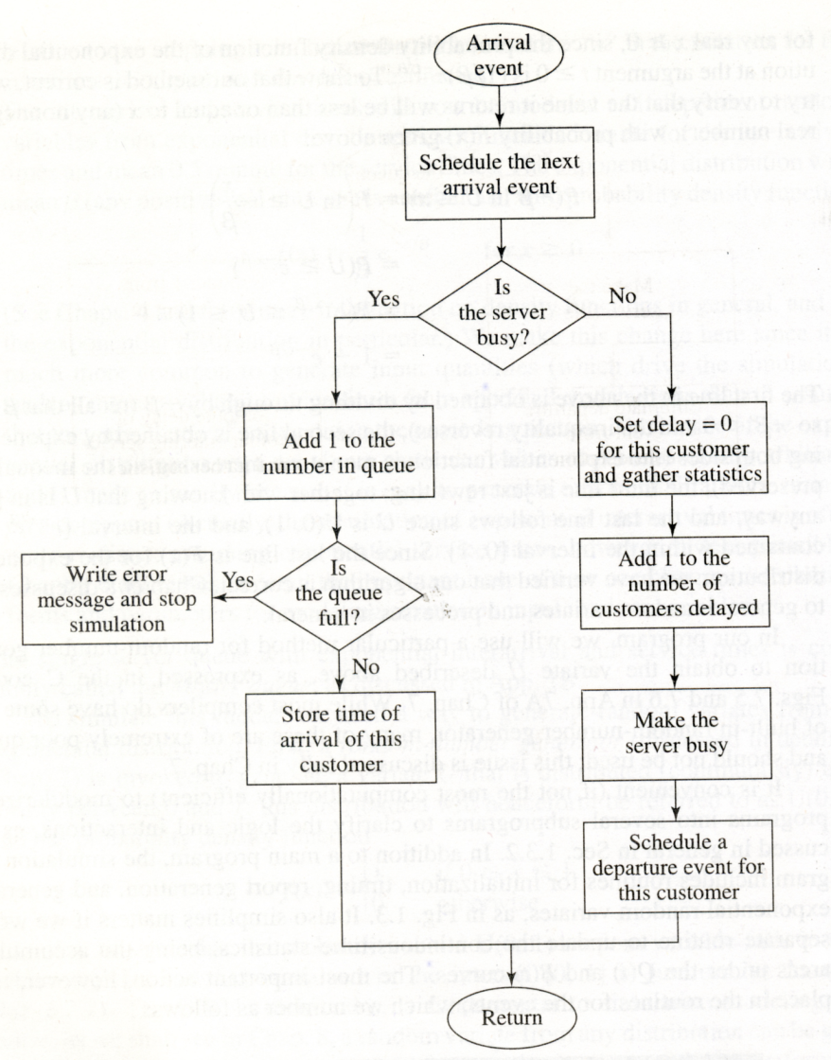
SSQS – Step 4: Computation Model

Slide 21
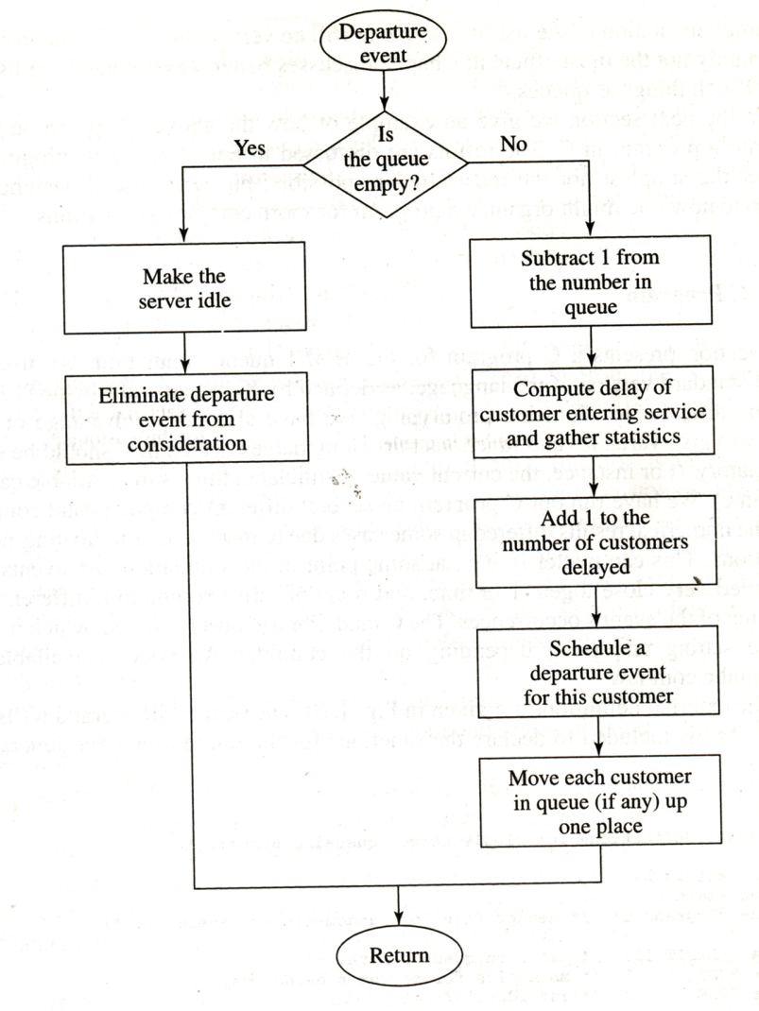
SSQS – Step 4: Computation Model

Slide 22
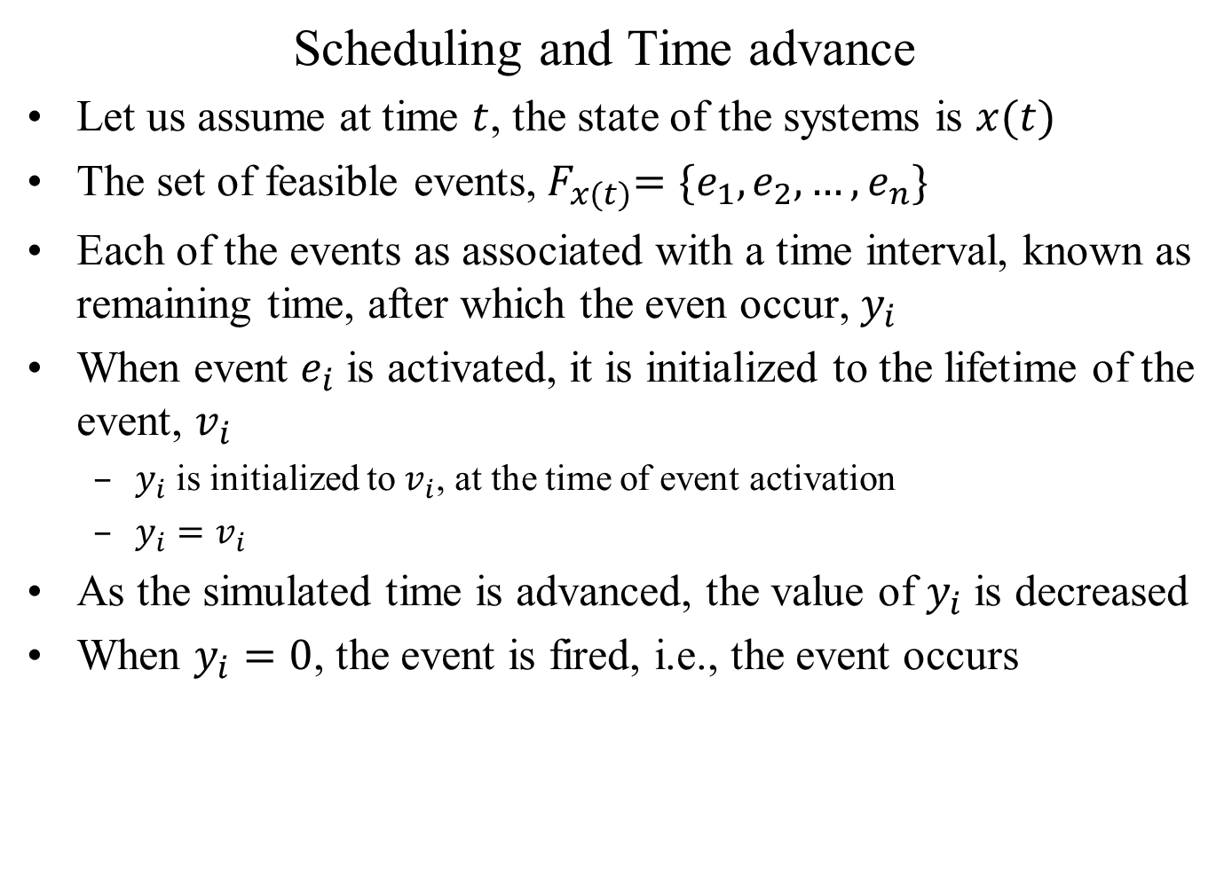
SSQS – Step 4: Computation Model
Scheduling and Time advance
Let us assume at time $t$, the state of the systems is $x(t)$
The set of feasible events,${ F}_{x(t)}=\{e_{1},e_{2},…,e_{n}\}$
Each of the events as associated with a time interval, known as remaining time, after which the even occur, $y_{i}$
When event $e_{i}$ is activated, it is initialized to the lifetime of the event, $v_{i}$
$y_{i}$ is initialized to $v_{i}$, at the time of event activation
$y_{i}=v_{i}$
As the simulated time is advanced, the value of $y_{i}$ is decreased
When $y_{i}=0$, the event is fired, i.e., the event occurs

Slide 23
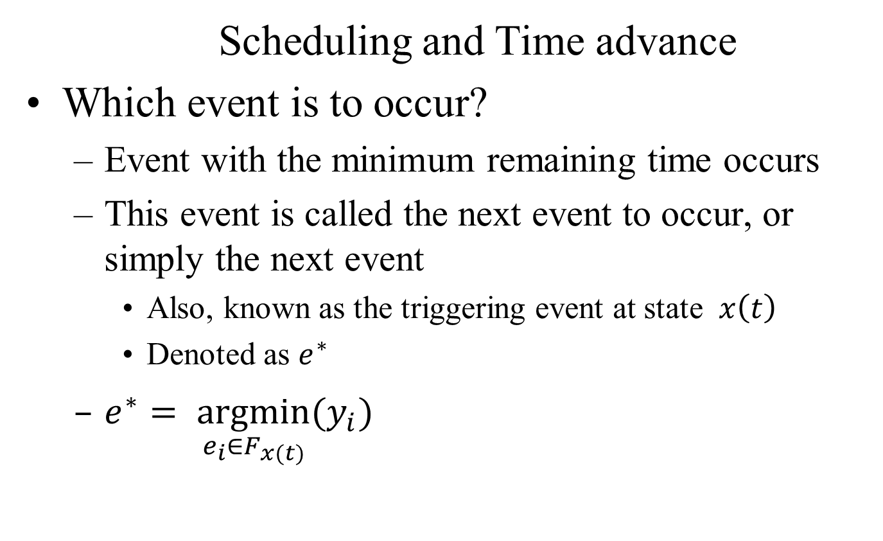
SSQS – Step 4: Computation Model
Scheduling and Time advance
Which event is to occur?
Event with the minimum remaining time occurs
This event is called the next event to occur, or simply the next event
Also, known as the triggering event at state $x\left(t\right)$
Denoted as $e^{∗}$
$e^{∗}= \underset{e_{i}∈F_{x(t)}}{argmin}{(y_{i})}$

Slide 24
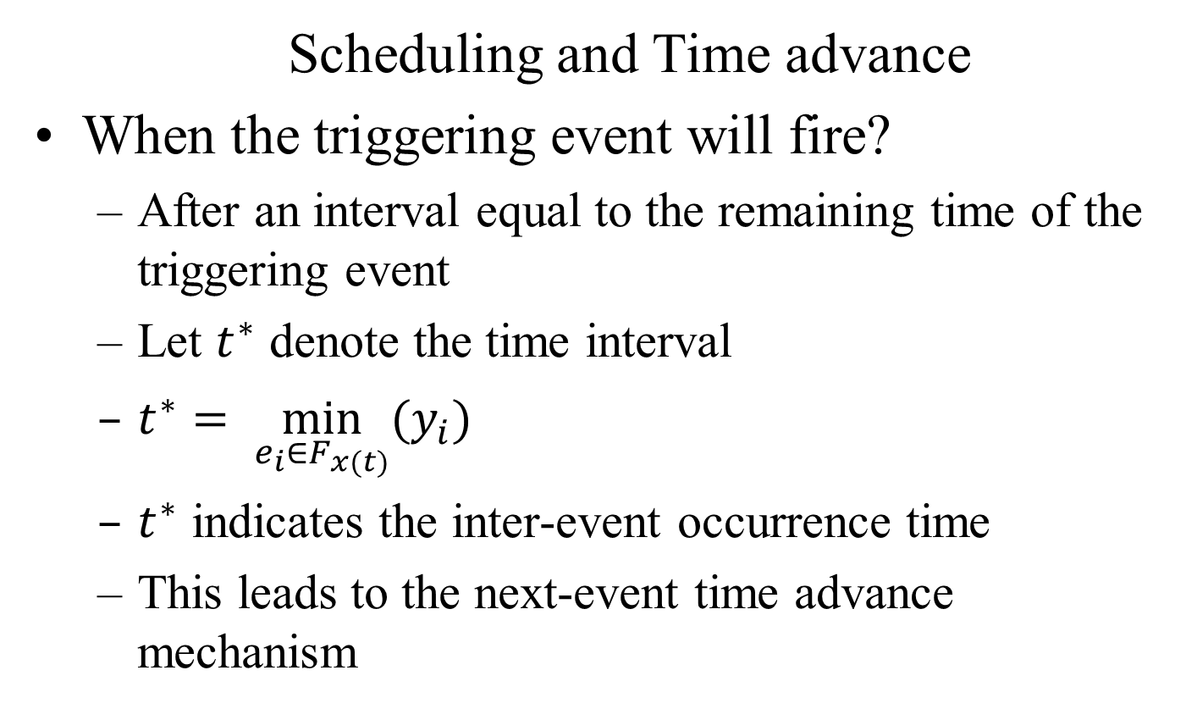
SSQS – Step 4: Computation Model
Scheduling and Time advance
When the triggering event will fire?
After an interval equal to the remaining time of the triggering event
Let $t^{∗}$ denote the time interval
$t^{∗}= \min_{e_{i}∈F_{x(t)}}{(y_{i})}$
$t^{∗}$ indicates the inter-event occurrence time
This leads to the next-event time advance mechanism

Slide 25
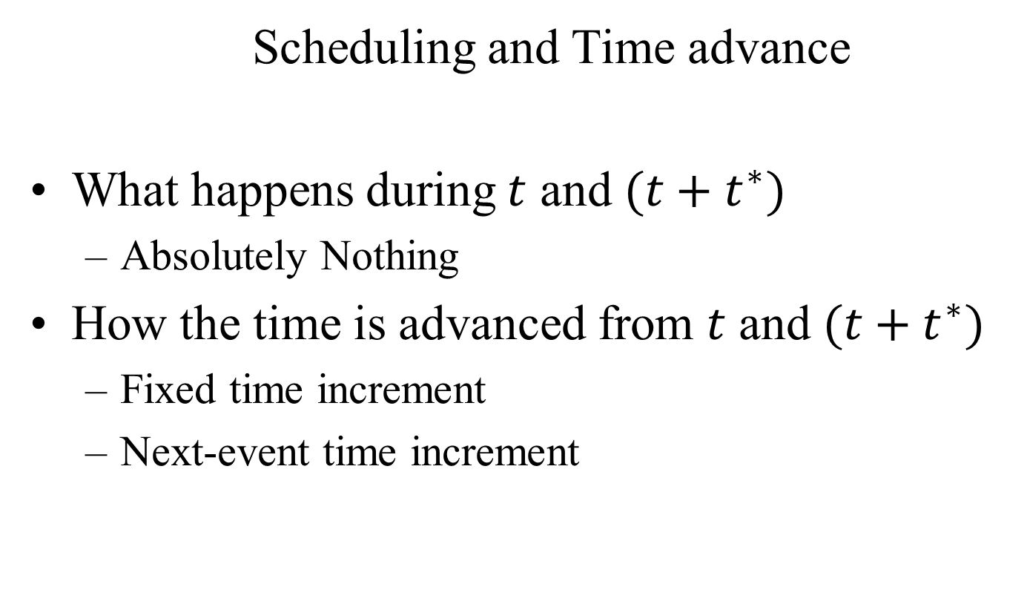
SSQS – Step 4: Computation Model
Scheduling and Time advance
What happens during $t$ and $(t+t^{∗})$
Absolutely Nothing
How the time is advanced from $t$ and $(t+t^{∗})$
Fixed time increment
Next-event time increment

Slide 26
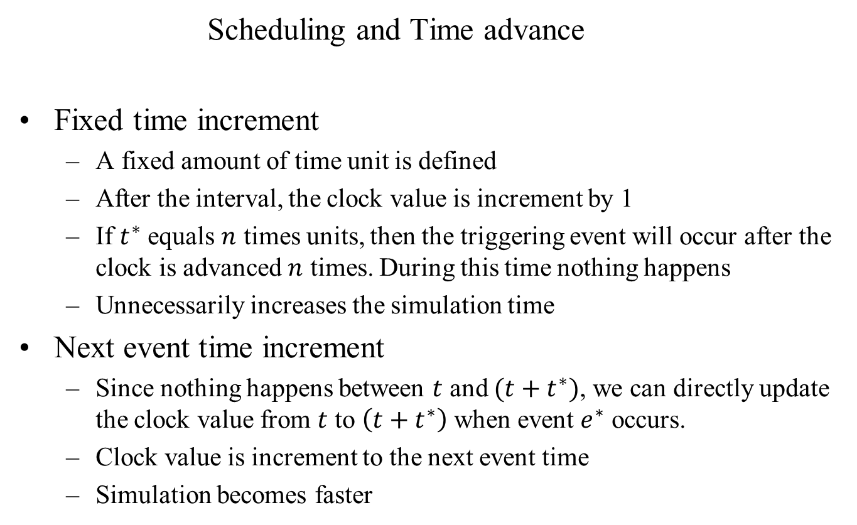
SSQS – Step 4: Computation Model
Scheduling and Time advance
Fixed time increment
A fixed amount of time unit is defined
After the interval, the clock value is increment by 1
If $t^{∗}$ equals $n$ times units, then the triggering event will occur after the clock is advanced $n$ times. During this time nothing happens
Unnecessarily increases the simulation time
Next event time increment
Since nothing happens between $t$ and $(t+t^{∗})$, we can directly update the clock value from $t$ to $\left(t+t^{∗}\right)$ when event $e^{∗}$ occurs.
Clock value is increment to the next event time
Simulation becomes faster

Slide 27
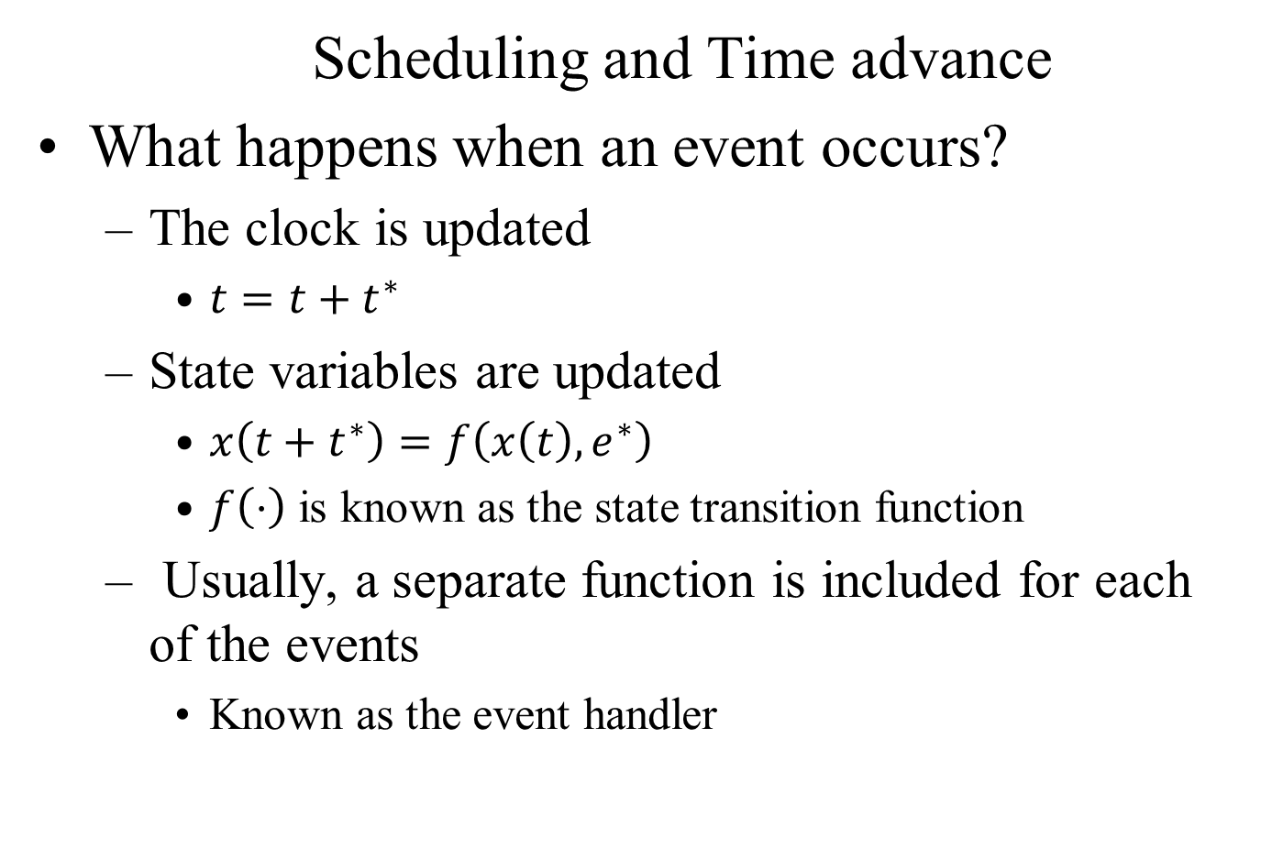
SSQS – Step 4: Computation Model
Scheduling and Time advance
What happens when an event occurs?
The clock is updated
$t=t+t^{∗}$
State variables are updated
$x\left(t+t^{∗}\right)=f\left(x\left(t\right), e^{∗}\right)$
$f\left(⋅\right)$ is known as the state transition function
Usually, a separate function is included for each of the events
Known as the event handler

Slide 28
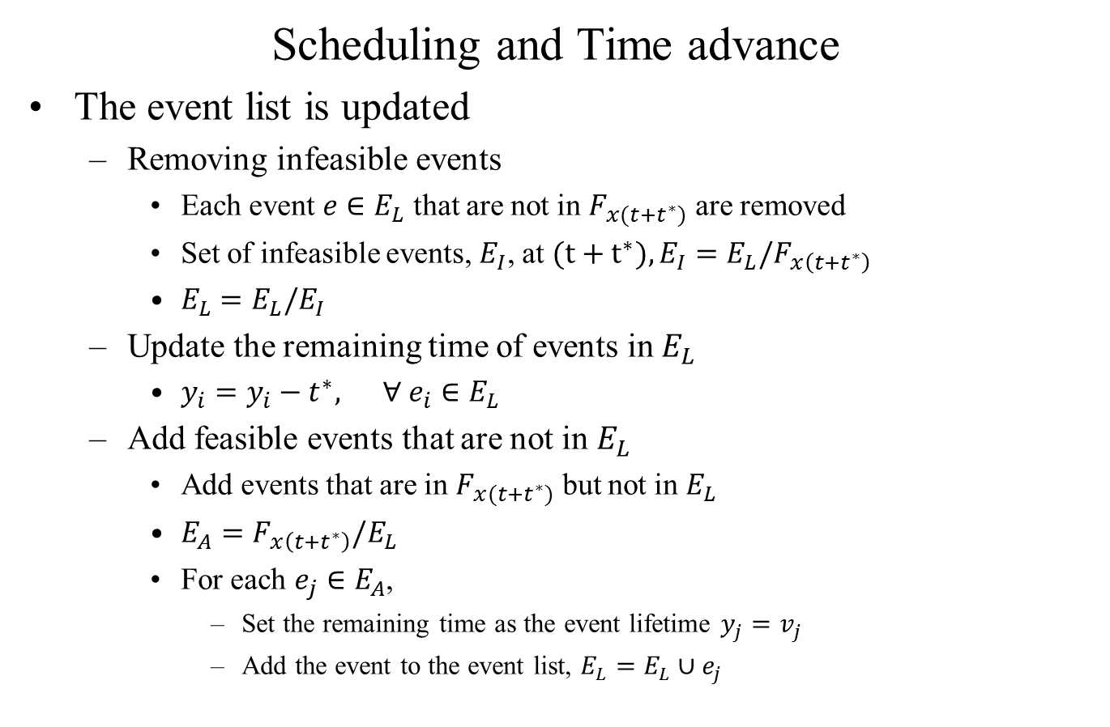
Scheduling and Time advance
The event list is updated
Removing infeasible events
Each event $e∈E_{L}$ that are not in $F_{x(t+t^{∗})}$ are removed
Set of infeasible events, $E_{I}$, at $(t+t^{∗}), E_{I}={E_{L}/F}_{x\left(t+t^{∗}\right)}$
$E_{L}=E_{L}/E_{I}$
Update the remaining time of events in $E_{L}$
$y_{i}=y_{i}−t^{∗}, ∀ e_{i}∈E_{L}$
Add feasible events that are not in $E_{L}$
Add events that are in $F_{x(t+t^{∗})}$ but not in $E_{L}$
$E_{A}=F_{x\left(t+t^{∗}\right)}/E_{L}$
For each $e_{j}∈E_{A}$,
Set the remaining time as the event lifetime $y_{j}=v_{j}$
Add the event to the event list, $E_{L}=E_{L}∪e_{j}$

Slide 29
Interarrival time --- Service Time
0.4 (0.4) 2.0 (2.4),
1.2 (1.6) 0.7 (3.1),
0.5 (2.1) 0.2 (3.3),
1.7 (3.8) 1.6 (4.9),
0.2 (4.0) 3.7 (8.6),
1.6 (5.6) 0.6 (9.2),
0.2, (5.8)
1.4, (7.2)
1.9, (9.1)

Slide 30
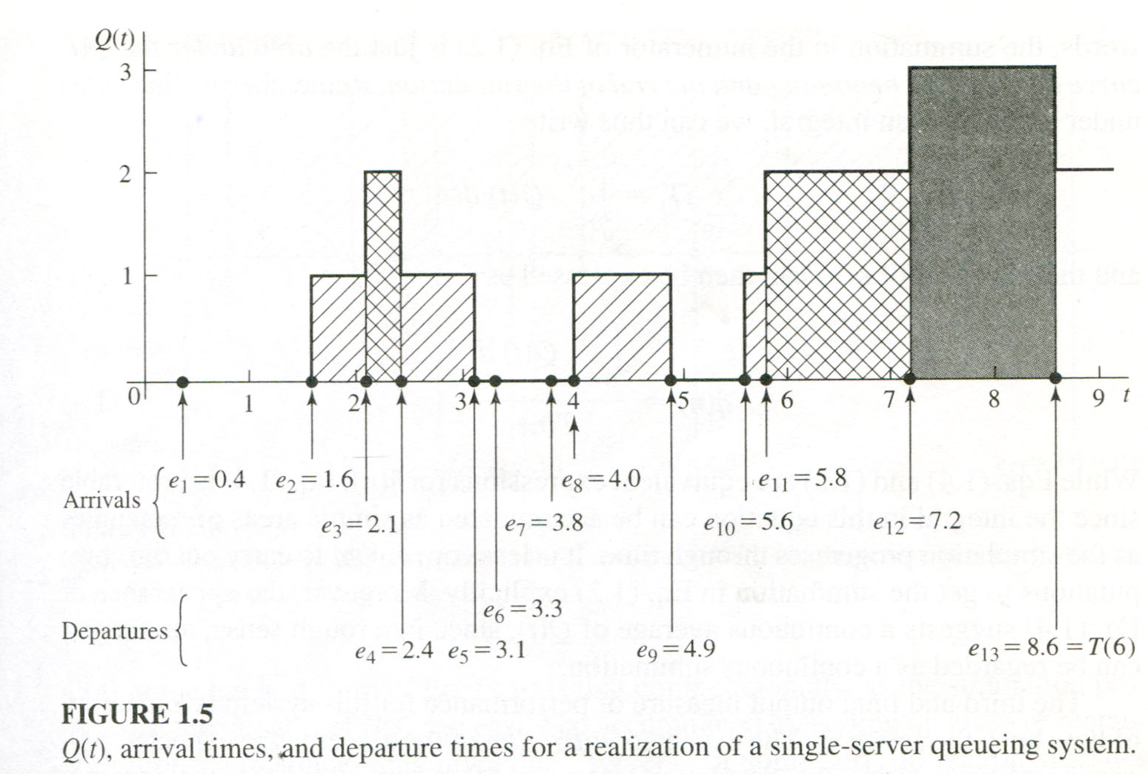

Slide 31
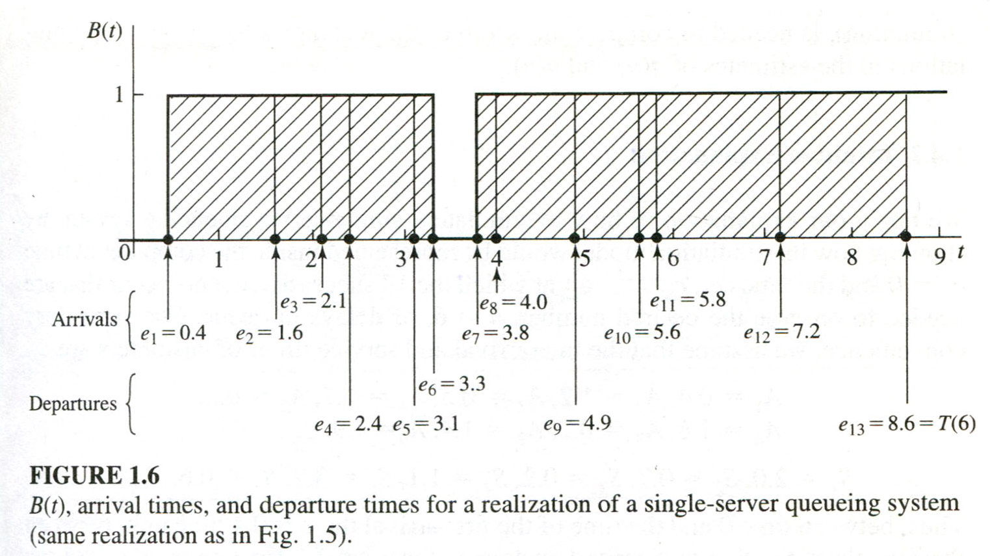

Slide 32
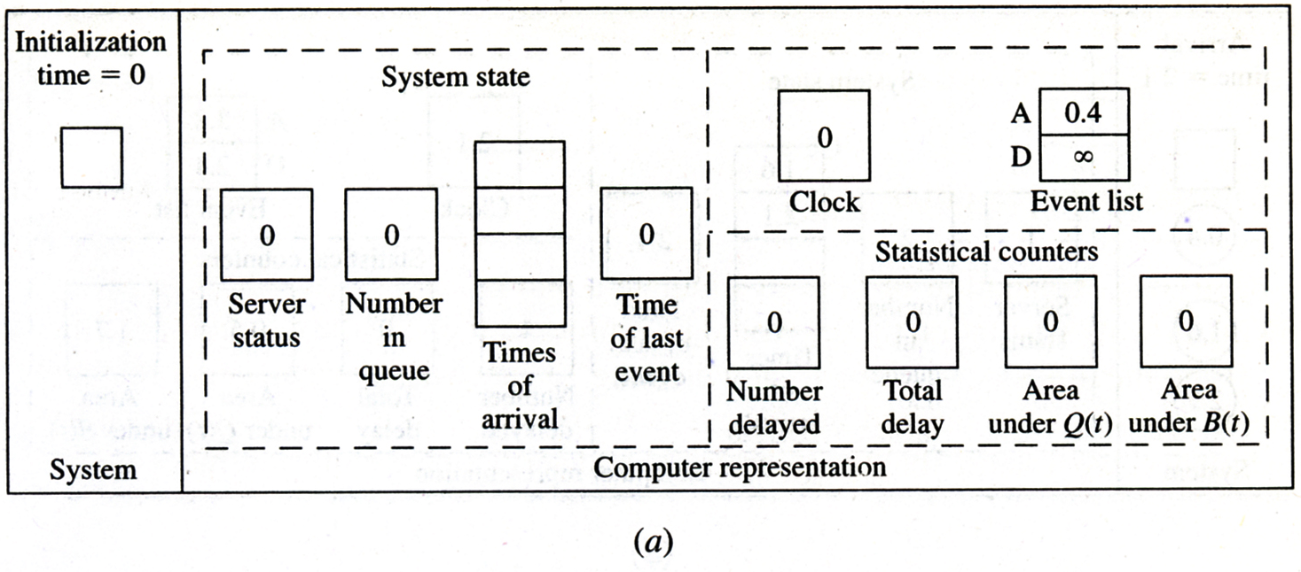
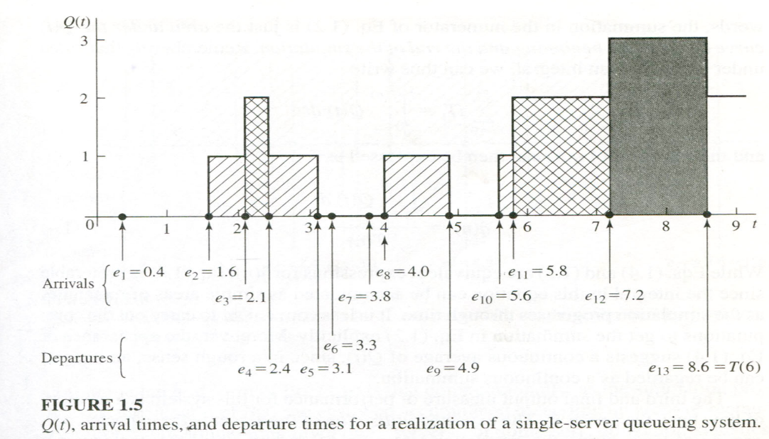
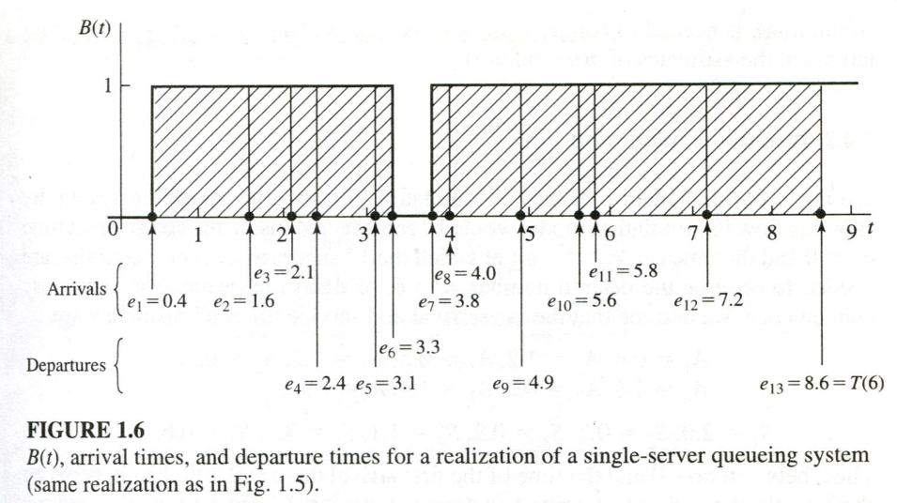
SSQS – Step 4: Computation Model

Slide 33
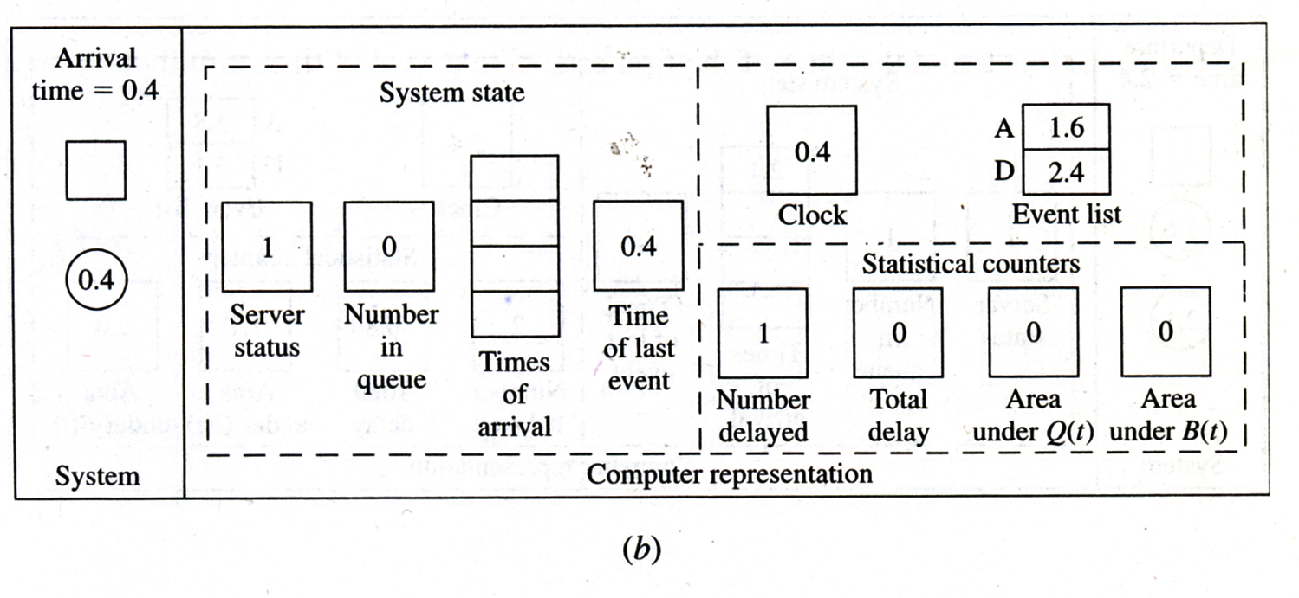
SSQS – Step 4: Computation Model

Slide 34
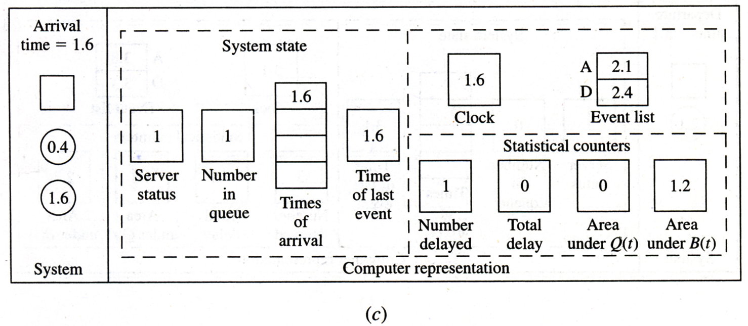
SSQS – Step 4: Computation Model

Slide 35
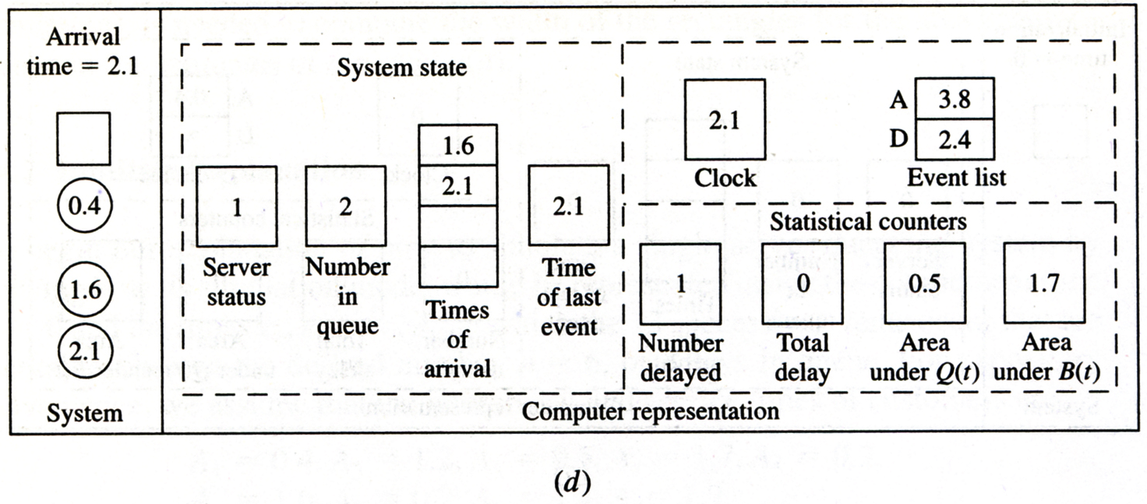
SSQS – Step 4: Computation Model

Slide 36
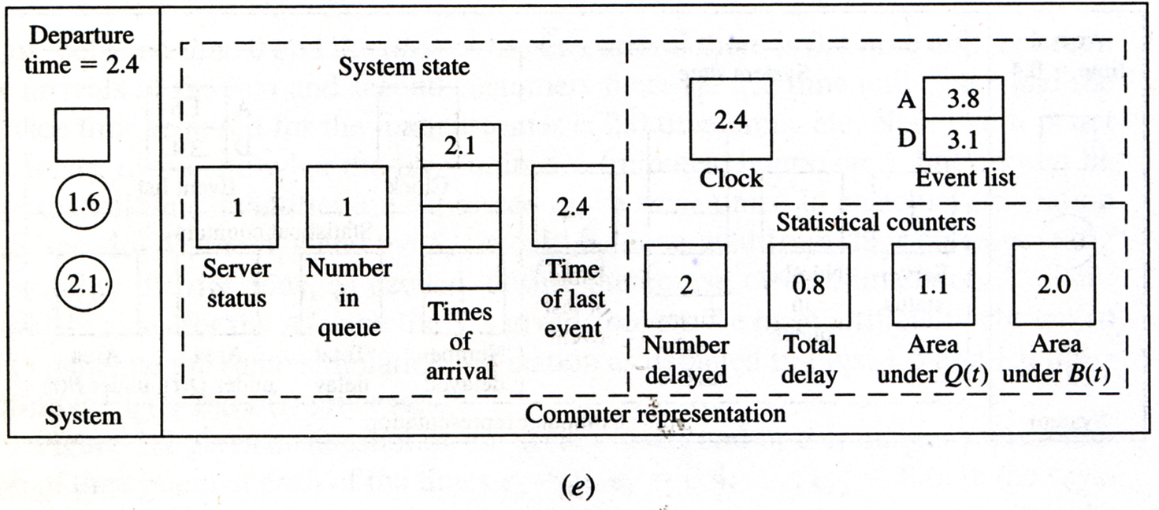
SSQS – Step 4: Computation Model

Slide 37
SSQS – Step 4: Computation Model

Slide 38
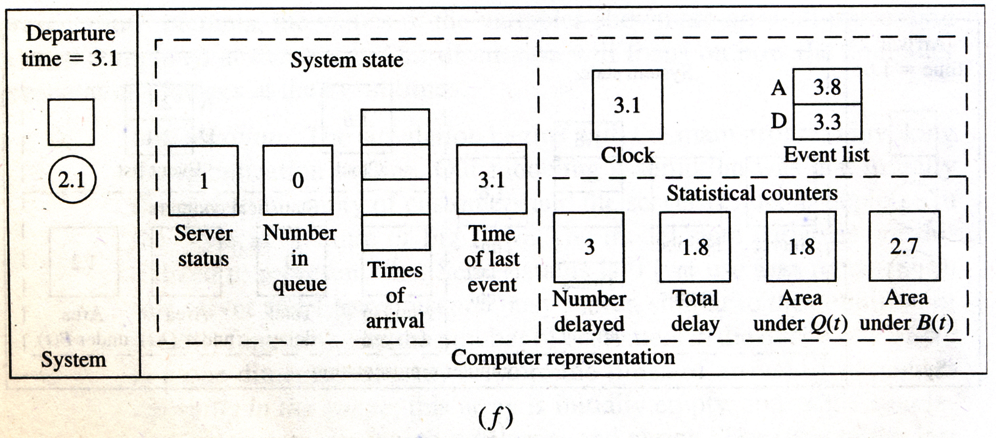
SSQS – Step 4: Computation Model

Slide 39
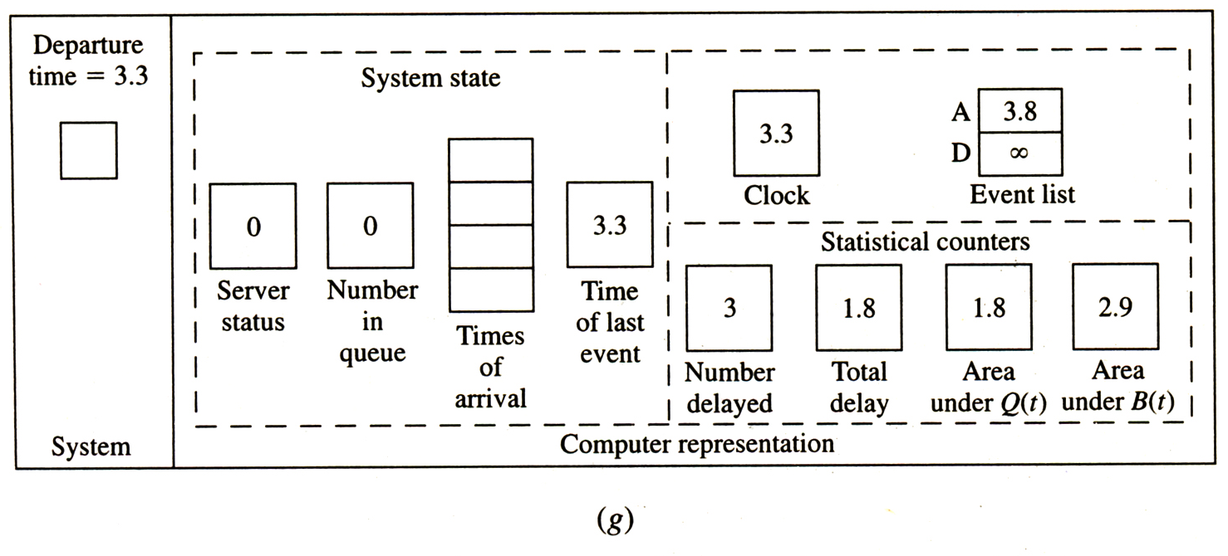
SSQS – Step 4: Computation Model

Slide 40
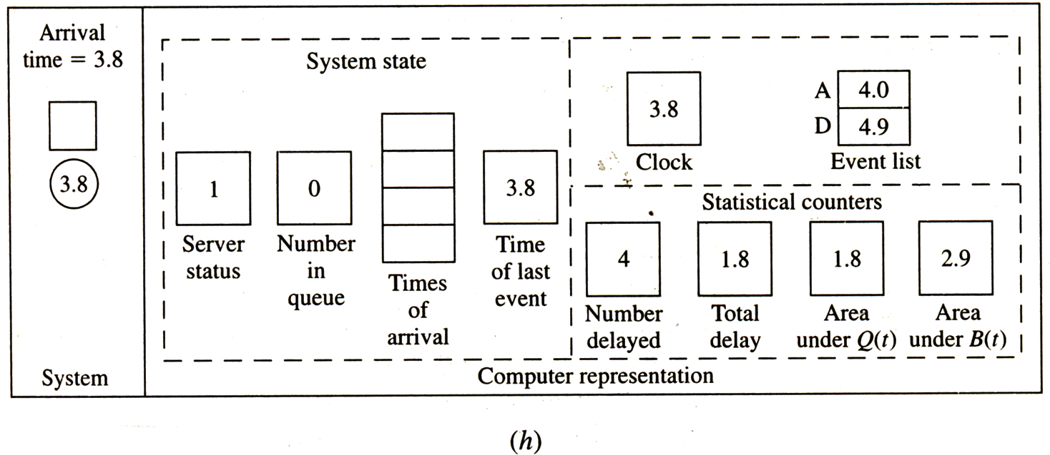
SSQS – Step 4: Computation Model

Slide 41
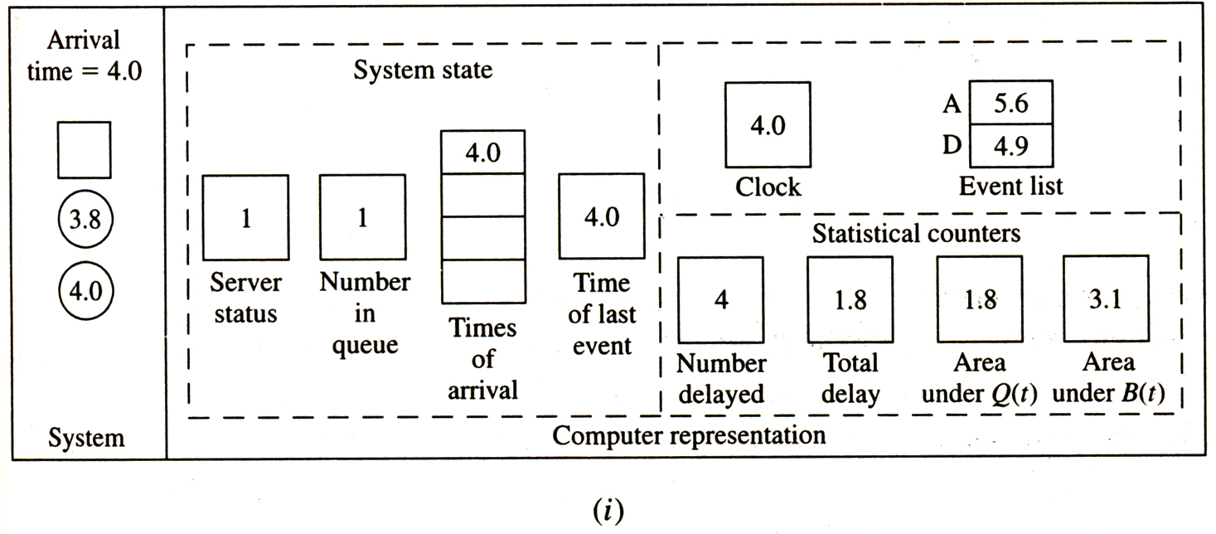
SSQS – Step 4: Computation Model

Slide 42
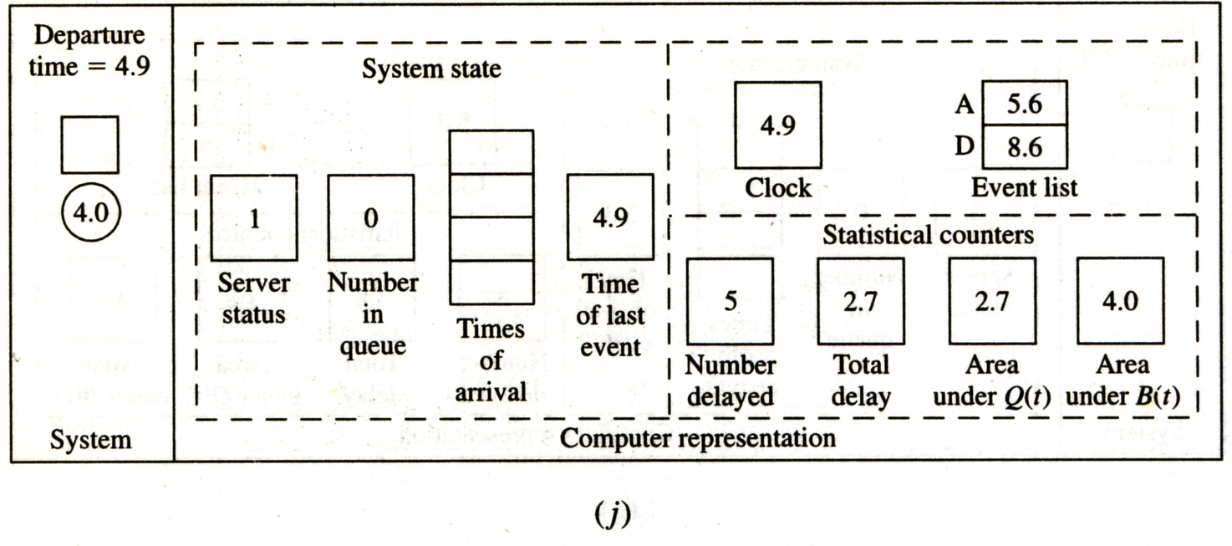
SSQS – Step 4: Computation Model

Slide 43
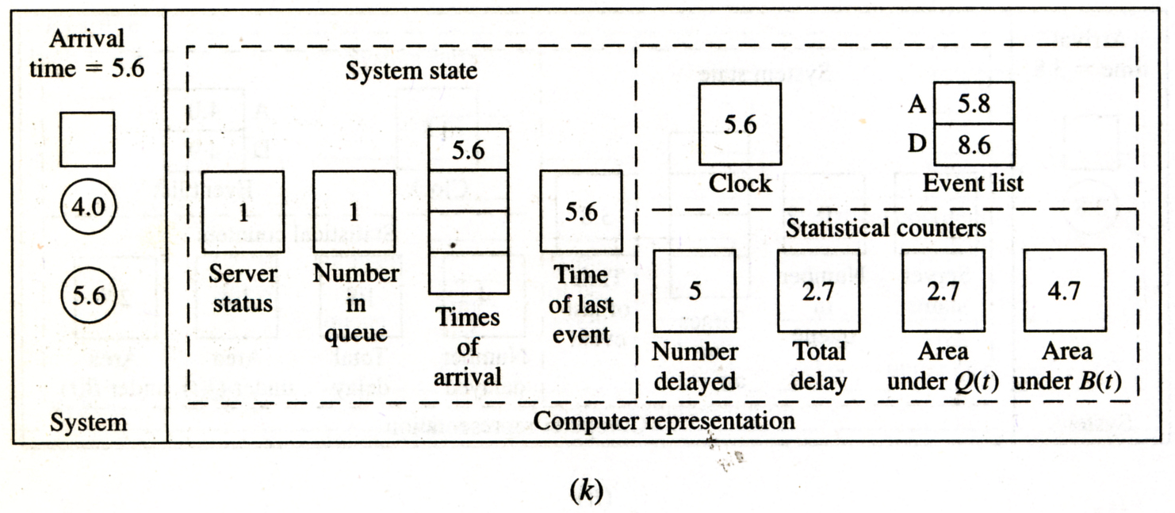
SSQS – Step 4: Computation Model

Slide 44
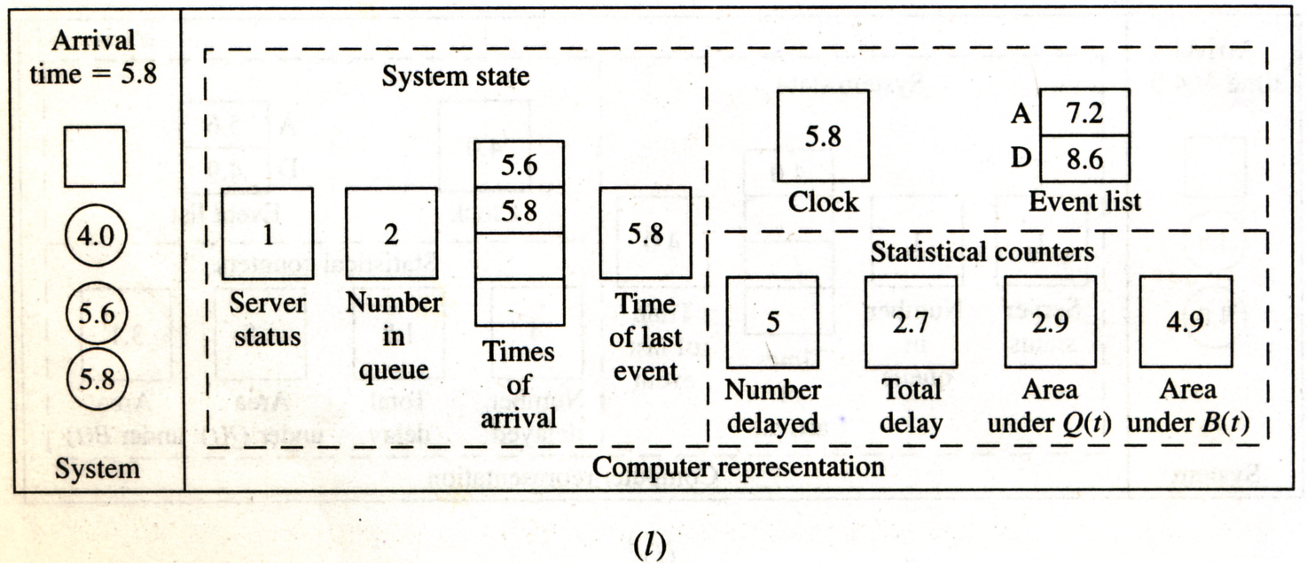
SSQS – Step 4: Computation Model

Slide 45
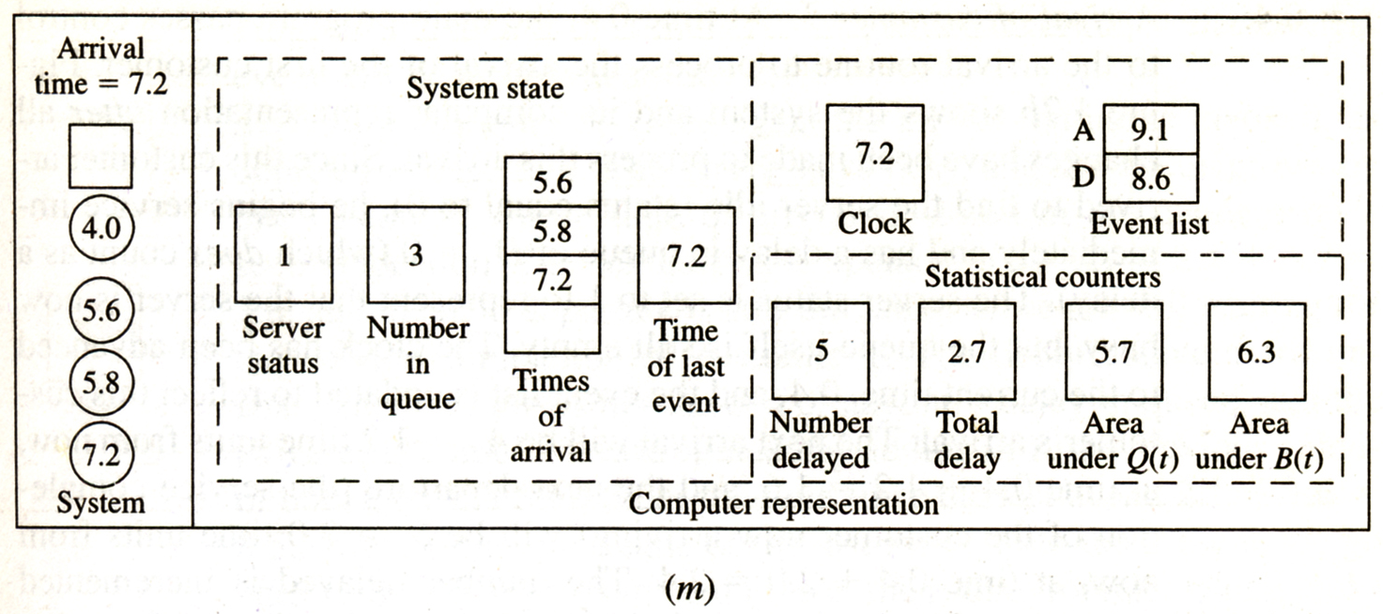
SSQS – Step 4: Computation Model

Slide 46
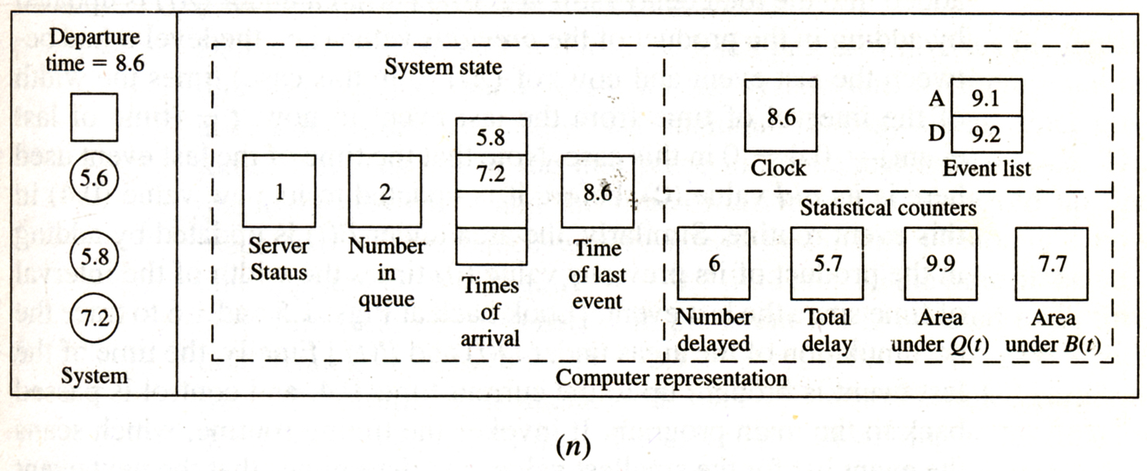
SSQS – Step 4: Computation Model

